Slide 1
Advanced ExpressJS
CORS, Environment Variables, Logging (Day 6)
Notes:
Photo by Mark König on Unsplash

Slide 2
Lesson Outcome
By the end of today, you should be able to:
Understand CORS and how to enable it in ExpressJS.
Understand environment variables and how to use them in ExpressJS.
Understand the importance of logging in RESTful APIs.

Slide 3
Recap: SQL Databases
SQL (Structured Query Language) is a standard language for interacting with databases. It is used across various database systems such as MySQL, PostgreSQL, SQLite, MariaDB, etc. The language design is highly structured and rule-based.
Revision: Intro to Databases (SQL)

Slide 4
SQL Terms
Database
Entities/Tables
Rows/Records/Tuples
Columns/Attribute/Fields
PK (Primary Key)

Slide 5
Basic SQL Commands
SELECT: get row(s) from a table
INSERT: add new row(s) to a table
UPDATE: change existing row(s) in a table
DELETE: remove row(s) from a table

Slide 6
SQL Clauses
LIMIT: Limit the number of rows returned. Used with SELECT command. (Eg. SELECT * FROM users LIMIT 10)
OFFSET: Skip a number of rows. Used with SELECT command. (Eg. SELECT * FROM users LIMIT 10 OFFSET 10)
ORDER BY: Sort the rows returned. Used with SELECT command. (Eg. SELECT * FROM users ORDER BY name ASC LIMIT 10 OFFSET 10)
WHERE: Filter the rows returned. Used with SELECT, UPDATE, DELETE commands. (Eg: UPDATE users SET name = 'John' WHERE id = 1)
JOIN: Combine rows from two or more tables. Used with SELECT command. (Eg. SELECT * FROM users JOIN posts ON users.id = posts.user_id)
GROUP BY: Group rows that have the same values into summary rows. Used with SELECT command. (Eg. SELECT COUNT(*) FROM users GROUP BY type)

Slide 7
Recap: Express JS
Express.js is a popular web application framework for Node.js. Commonly used for building RESTful APIs and server-side applications. It provides a good set of features and tools for building robust and scalable applications making it a popular choice among developers.
Revision: Introduction to REST APIs and CRUD

Slide 8
Express Terms
Request: The request object represents the HTTP request and has properties for the request query string, parameters, body, HTTP headers, etc.
Response: The response object represents the HTTP response that an Express app sends when it gets an HTTP request.
Middleware: Middleware are functions that have access to the req and res objects and the next function in the application's request-response cycle. They can perform additional operations, modify the request or response objects, and pass control to the next middleware function.
Routes/Endpoints: A route is a section of Express code that associates an HTTP verb (GET, POST, PUT, DELETE, etc.), a URL path/pattern, and a function that is called to handle that pattern.

Slide 9
What is Request-Response Cycle?
Request-Response Cycle is the flow of communication between the client and the server. The client makes a request to the server and the server responds to the request. The request can be of any type such as GET, POST, PUT, DELETE, etc.

Slide 10
The Flow
Request -> Middleware (optional) -> Middleware (optional) -> Route Handler -> Do something -> Response

Slide 11
Routes
Routes also known as endpoints are the URLs that the client makes a request to.
In a nutshell, routes are used to define the behaviour of the application when a client makes a request to the server.
app.get("/say-hello-world", (req, res) => {
res.send("Hello World!");
});

Slide 12
Path Parameters
Path parameters are used to pass data to the server. They are defined in the route URL. The data passed can be accessed in the route handler using req.params.
app.get("/users/:id", (req, res) => {
const id = req.params.id;
res.send(`User ID: ${id}`);
});

Slide 13
Query Parameters
Similar to path parameters, query parameters are used to pass data to the server. They can be passed in the URL after a ? and separated by &. The data passed can be accessed in the route handler using req.query.
app.get("/users", (req, res) => {
const limit = parseInt(req.query.limit);
const offset = parseInt(req.query.offset);
// Do something with the data
res.send(`I got ${limit} users starting from ${offset}`);
});

Slide 14
Don't forget the data types!
Any key-value pair from the req.params and req.query will be of type string by default. It is important to convert them to the appropriate data type before using them.

Slide 15
You can chain the response methods!
// Sets the status code to 200 and sends the response
res.status(200).send("Hello World!");
// Sets the status code to 301 and redirects the client to the specified URL
res.status(301).redirect("https://google.com");

Slide 16
Pagination and Sorting
Pagination and sorting are common features integrated in RESTful APIs. They are used to limit the number of results returned from the database and sort them in a particular order.
Eg: GET /users?limit=10&offset=10&sortBy=name&sortOrder=desc
This can be translated to (in SQL):
SELECT * FROM users ORDER BY name DESC LIMIT 10 OFFSET 10
Similarly, if using NoSQL databases such as MongoDB, the query will be:
db.users.find().sort({ name: -1 }).limit(10).skip(10);

Slide 17
What are Middlewares?
Middleware are functions that have access to the req and res objects and the next function in the application's request-response cycle. They can perform additional operations, modify the request or response objects, and pass control to the next middleware function.
Middlewares can be a custom function or a third-party package. Popular packages include express-validator, passport, compression, cors, etc.

Slide 18
Recap: MVC Pattern, ORMs, and Sequelize
Having a good project structure is important for building scalable applications. MVC (Model-View-Controller) is a popular design pattern used to structure applications. It separates the application into three main components: Model, View, and Controller.
In the MVC pattern, the application is divided into three components or layers:
Model: Responsible for managing data layer.
View: Responsible for rendering data and presenting it to the user. aka the Frontend.
Controller: Responsible for handling user requests, interacting with the Model, and updating the View.
Revision: Integrating a SQL Database to the REST API

Slide 19
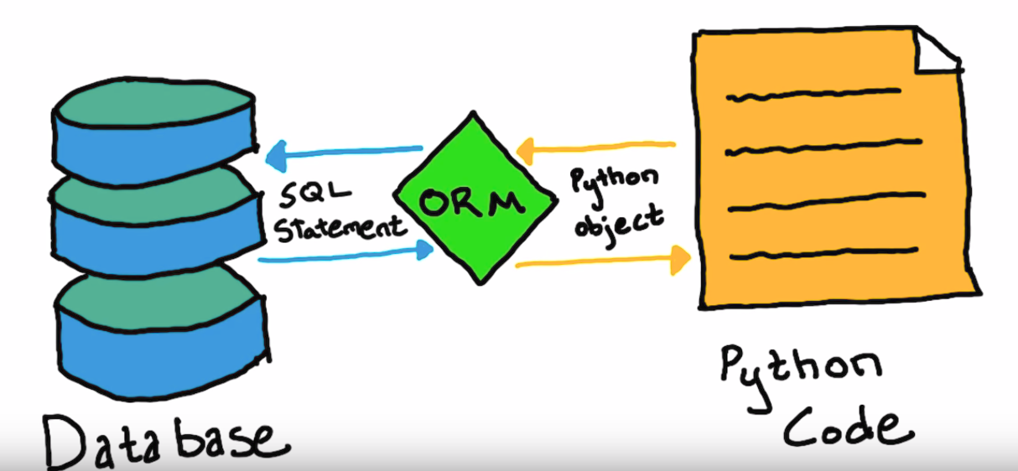
ORM
ORM is an acronym for Object Relational Mapping. ORM act as a bridge between databases and object oriented programming model code. Traditionally, to access data in a database, one needs to write stored procedure or SQL query to do so. With ORM, it eliminates the complexity of writing a query for every task you need to do.

Slide 20
Sequelize
Sequelize is an ORM (Object Relational Mapping) library for Node.js. It supports multiple SQL dialects, including MySQL, PostgreSQL, SQLite, and MSSQL.
Say we have a database with a table called users. To retrieve all the users from the database, we'd have to write a SQL query like this:
SELECT * FROM users;
This works only if you're in a supported SQL database. In Node.js, there is no built-in way to interact with a database. You would have to use a driver to interact with the database. This is where Sequelize comes in. It acts as a bridge (driver) between your Node.js application and the database.

Slide 21
Models
Since models are the data layer of the application, it is important to define the schema of the data. This is where models come in. Models are used to define the schema of the data. It is a representation of a table in the database.
Example of a model using Sequelize (in next slide):

Slide 22
const Blog = sequelize.define(
"Blog",
{
id: {
type: DataTypes.INTEGER,
primaryKey: true,
autoIncrement: true,
field: "id",
},
title: {
type: DataTypes.STRING,
allowNull: false,
field: "title",
},
...
},
{
tableName: "blogs",
timestamps: false,
}
);

Slide 23
Controllers
Controllers are simply functions that handle user requests, interact with the Model, as a result, the controller always updates the View (response). For example, if a client makes a POST request to /blogs, the controller will create a new blog post and send a response back to the client.
Example of a controller:
const getBlogs = async (req, res) => {
try {
const blogs = await Blog.findAll();
res.status(200).json(blogs);
} catch (error) {
res.status(500).json({ error: error.message });
}
};

Slide 24
Routes
Routes are used to define the behaviour of the application when a client makes a request to the server. It is also known as endpoints. In MVC pattern, controllers are mapped to routes.
Example of a route:
app.get("/blogs", getBlogs);
In this case, getBlogs refers to the controller function that will be executed when a client makes a GET request to /blogs.

Slide 25
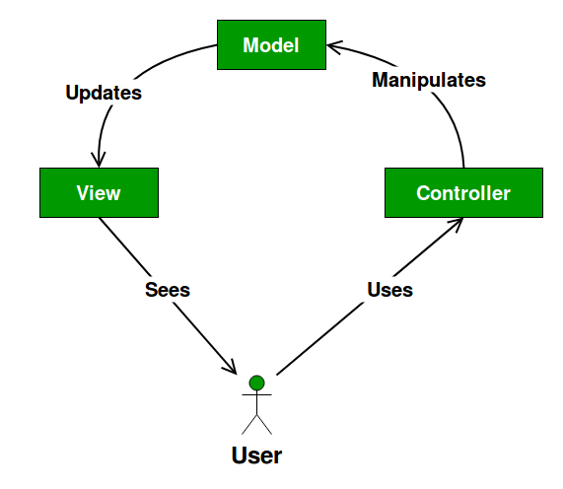
MVC Diagram

Slide 26
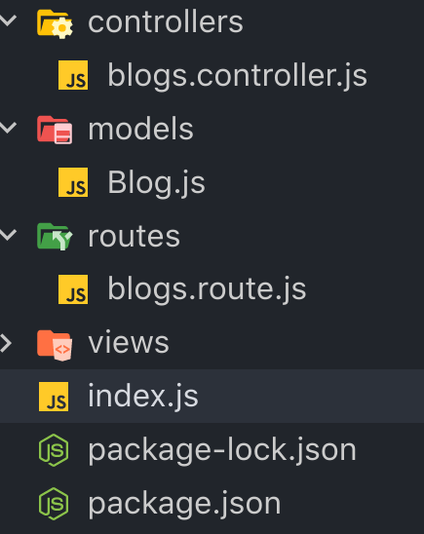
Implementing MVC Pattern
The usual way of implementing MVC pattern is to create a folder for each component (Model, View, Controller) and put the files in their respective folders. For example, if you have a Blog model, you would create a Blog.js file in the models folder. Similarly, if you have a getBlogs controller, you would create a getBlogs.js file in the controllers folder.

Slide 27
Advanced Express - CORS
When it comes to building an API, CORS is one of the most important things to consider. CORS stands for Cross-Origin Resource Sharing.
It is a mechanism that allows a web application running at one origin (domain) to access the resources from a server at a different origin. It's a security feature built into browsers to prevent malicious scripts from accessing resources from a different origin.
Different origins mean different domain, protocol, or port. Eg. http://localhost:3000 and http://localhost:8080 are different origins.

Slide 28
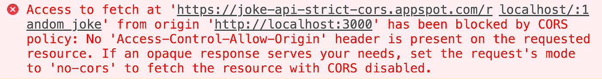
Why do we need CORS?
Let's say you have an API running on http://localhost:3000 and a frontend application running on http://localhost:8080. When you make a request to your API from the frontend application, you will get an error saying that the request has been blocked by CORS policy.

Slide 29
What about Insomnia/Postman?
Insomnia and Postman are tools for testing APIs. They are not browsers. They do not have the same security features as browsers. That's why you can make requests to your API from Insomnia/Postman without any issues.

Slide 30
But why?
Think of an API as your house. You probably don't want to allow everyone to enter your house. You only want to allow specific people to enter your house. Similarly, CORS is disabled by default in Express because it is not recommended to allow all origins to access your API. It is a security risk. You should only allow specific origins to access your API. For example, if your frontend is hosted at https://my-frontend.com, you should only allow that origin to access your API.

Slide 31
How do we allow CORS?
Well it's quite straightforward. You just need to add a middleware to your Express application.
Install the cors package.
npm install cors
Import the cors package.
const cors = require("cors");
Add the middleware to your Express application.
app.use(cors());
This will allow all origins to access your API. If you want to allow only specific origins, you can do so by passing in an options object to the cors function.
const corsOptions = {
origin: "http://localhost:8080",
};
app.use(cors(corsOptions));

Slide 32
Advanced Express - Environment Variables
Environment variables are key-value pairs that are set in the environment in which the application is running. They are used to store sensitive information such as API keys, database credentials, etc. They are also used to store configuration values such as the port number the application should listen on. Environment variables are usually set in a .env file.
Let's say you have an API that connects to a database. You probably don't want to hardcode the database credentials in your code. You want to store them in a safe place. That's where environment variables come in. You can store the database credentials in a .env file and access them in your code. Environment files are usually not committed to version control. They are usually ignored by .gitignore.

Slide 33
Staging, Production and Development Environments
When you're developing an application, you usually have a development environment and a production environment. The development environment is where you develop the application. The production environment is where the application is deployed. You might also have a staging environment where you test the application before deploying it to production.
Based on the environment, you might have different database credentials, API keys, etc. If we hard-code these values in our code, we would have to change them manually for each environment. In coding terms, this is called hardcoding. It's not a good practice.

Slide 34
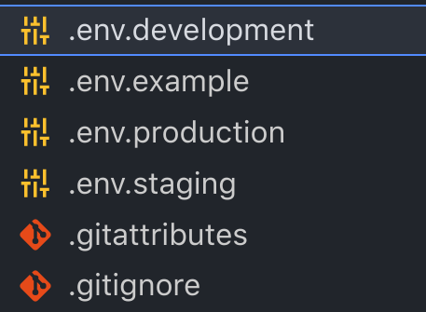
Real World Example - Explanation
The following is an actual application that has three environments: development, staging and production. There are three env files: .env.development, .env.staging and .env.production. The values in these files are different for each environment.
These files are not committed to version control. They are ignored by .gitignore.

Slide 35
How do we use environment variables?
Install the dotenv package.
npm install dotenv
Create a .env file in the root directory of your project.
PORT=3000
SOME_API_KEY=123456789
Import the dotenv package.
require("dotenv").config();
Access the environment variables.
const port = process.env.PORT;
const someApiKey = process.env.SOME_API_KEY;

Slide 36
Using Different Env Files
If you have multiple stages (development, production), you can use different env files for each stage. For example, you can have a .env.development file for the development stage and a .env.production file for the production stage. You can then use the NODE_ENV environment variable to determine which env file to use.
if (process.env.NODE_ENV === "production") {
require("dotenv").config({ path: ".env.production" });
} else {
require("dotenv").config({ path: ".env.development" });
}

Slide 37
Using Different Env Files (cont.)
In your package.json file, you can set the NODE_ENV environment variable to production or development by using npm scripts.
{
"scripts": {
"prod": "NODE_ENV=production node index.js",
"dev": "NODE_ENV=development nodemon index.js"
}
}
Running npm run prod will set the NODE_ENV environment variable to production and run the application. Running npm run dev will set the NODE_ENV environment variable to development and run the application using nodemon.

Slide 38
Advanced Express - Logging
Logging is the process of recording events that occur in an application. It is used to monitor the application and troubleshoot problems. It is also used to keep track of user activity. For example, if a user logs in to your application, you might want to log that event so that you can see who logged in and when they logged in.

Slide 39
Morgan (Not Morgan Freeman)
Morgan is a popular logging middleware for Express. It is used to log HTTP requests. It can log requests in different formats such as Apache, Common, Combined, Dev, Short, Tiny, etc. It can also log requests in JSON format.

Slide 40
Using Morgan
Install the morgan package.
npm install morgan
Import the morgan package.
const morgan = require("morgan");
Add the middleware to your Express application.
app.use(morgan("dev"));

Slide 41
Advanced Express - Other Third-Party Loggers
Other than Morgan, there are other third-party loggers such as Sentry. Sentry is more than just a logger. It is a platform for monitoring applications. It can be used to log errors, performance issues, etc. It can also be used to send alerts when something goes wrong.
Using Sentry will make your life easier because you won't have to worry about logging errors yourself. You can just use Sentry to log errors and send alerts when something goes wrong.
Explore Sentry here.

Slide 42
Self Cover: Revision MVC Pattern Module

Slide 43
Task of the day Task of the Day: Build a Task Management System

Slide 44
Task of the day - Overview Task of the Day: Build a Task Management System
There are three user roles in the system: admin, manager, and employee.
Projects have a name, description, start and expected end dates.
Tasks belong to a project. Tasks have a name, description, status, and due date.
Projects are assigned to managers by admins.
Tasks can be assigned to employees by managers.

Slide 45
Task of the day - Database Schema Goal: Using Beekeeper Studio, come up with the database schema for a task management system.
Figure out the entities involved in the System. Eg: users, tasks, projects, and user roles.
Figure out the relationships between the entities. For instance, a user can have multiple tasks assigned to them, and a project can have multiple tasks associated with it.
Define the attributes and data types for each entity.
Hint: Draw out the ERD diagram first and then create the schema.

Slide 46
Task of the day - Models Goal: Create the Sequelize models for all entities in the database.
Create a separate model file for each entity in the system, following the MVC pattern.
Show the relationships between the models. For example, a user may have a foreign key to reference their assigned tasks.

Slide 47
Task of the day - MVC Pattern Goal: Implement proper MVC pattern
Keep in mind the Model-View-Controller (MVC) pattern while designing the database schema and models.
The models should exactly represent the entities in the database schema.
The views and controllers are not required for this task.
Use environment variables to store the database credentials.
Add logging using Morgan middleware to log all requests to the console. The log should include the request body, path params, query params, time of the request, and user-agent string (browser’s information).

Slide 48
Take home tasks

Slide 49
Some homework 📚
Implement the controllers and routes for the Task Management System.
Implement validations where appropriate.

Slide 50
References
MVC Pattern
Sequelize Data Types
Sequelize Raw Queries
Sequelize Validations
Morgan Documentation
Dotenv Documentation

